Slide 1
S.C. CPMC with BCS states
icf

Slide 2
Outline
Introduction of the S.C. CPMC algorithm
The behavior of the S.C. CPMC algorithm in Hubbard Model
Some problems need to be solved next
Application

Slide 3
Introduction of the S.C. CPMC algorithm
Self Consistence
Get a Trial Wave Function
CPMC Calculation
Get The Information of Ground State

Slide 4



Introduction of the S.C. CPMC algorithm
: Get the Green Function $<C_{iσ}^{+}C_{jσ}>$
: Construct a Trial Wave Function with the same Green Function as the Ground State

Slide 5

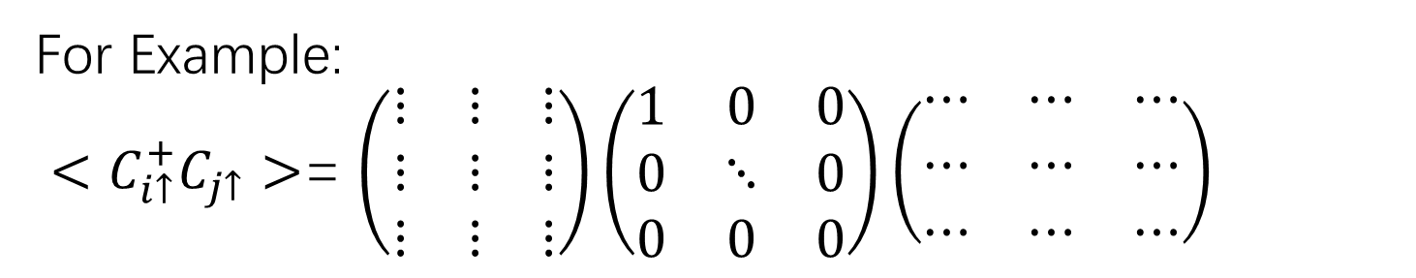
Introduction of the S.C. CPMC algorithm
: With DET Trial Wave Function
Claim 1.1:
If a state can be represented as one DET state,
Then the DET state is the eigenstates of its Green Function
For Example:
$<C_{i↑}^{+}C_{j↑}>$= $\left(\begin{matrix}⋮ & ⋮ & ⋮ \\ ⋮ & ⋮ & ⋮ \\ ⋮ & ⋮ & ⋮\end{matrix}\right)\left(\begin{matrix}1 & 0 & 0 \\ 0 & ⋱ & 0 \\ 0 & 0 & 0\end{matrix}\right)\left(\begin{matrix}⋯ & ⋯ & ⋯ \\ ⋯ & ⋯ & ⋯ \\ ⋯ & ⋯ & ⋯\end{matrix}\right)$

Slide 6
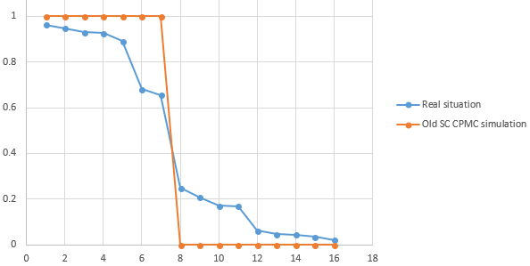

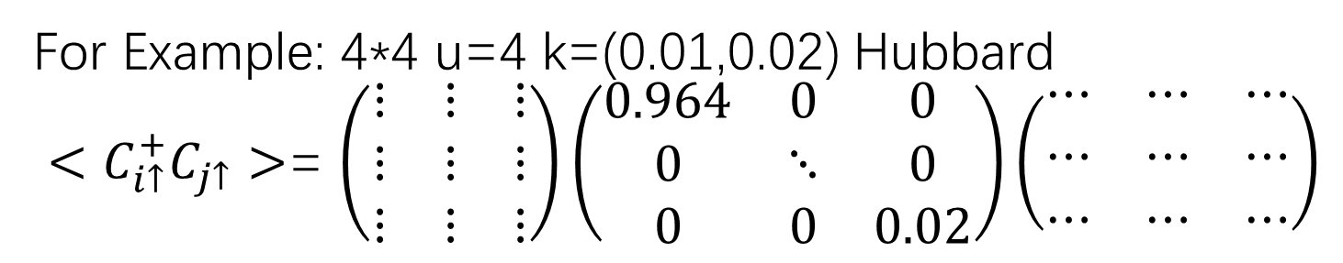
Introduction of the S.C. CPMC algorithm
Normally, the Ground State is a superposition of many DET states
For Example: 4*4 u=4 k=(0.01,0.02) Hubbard
$<C_{i↑}^{+}C_{j↑}>$= $\left(\begin{matrix}⋮ & ⋮ & ⋮ \\ ⋮ & ⋮ & ⋮ \\ ⋮ & ⋮ & ⋮\end{matrix}\right)\left(\begin{matrix}0.964 & 0 & 0 \\ 0 & ⋱ & 0 \\ 0 & 0 & 0.02\end{matrix}\right)\left(\begin{matrix}⋯ & ⋯ & ⋯ \\ ⋯ & ⋯ & ⋯ \\ ⋯ & ⋯ & ⋯\end{matrix}\right)$

Slide 7
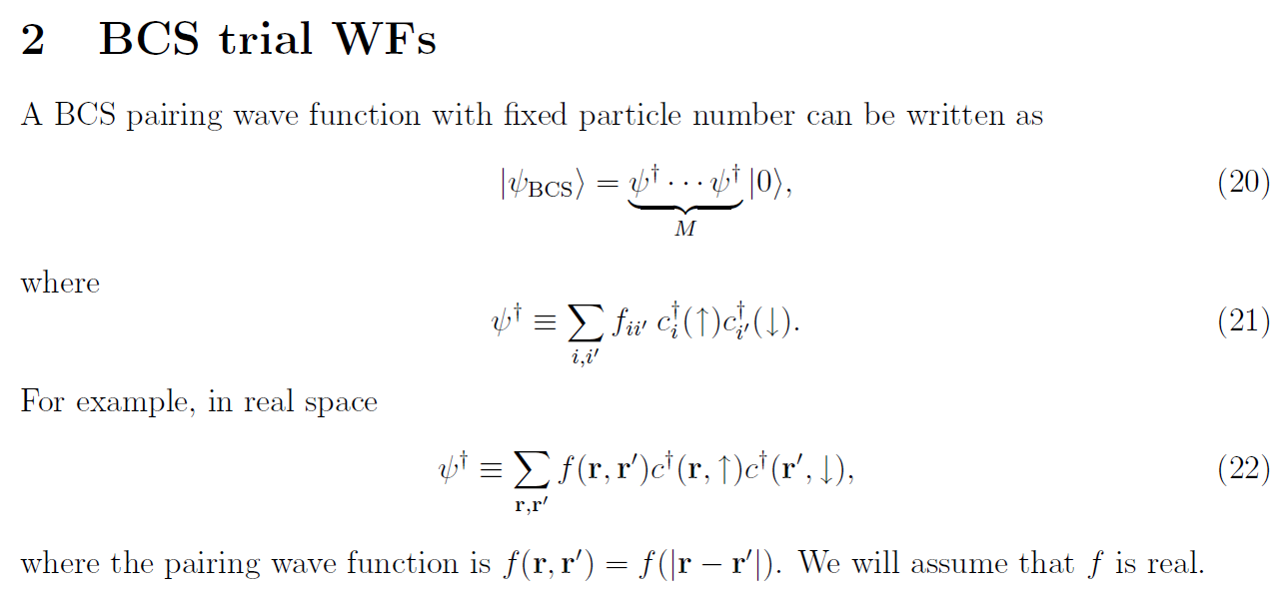
Introduction of the S.C. CPMC algorithm
BCS state (particle projected state of HFB state)
[1] zhang, shiwei Notes: BCS trial WFs and Hubbard-like models

Slide 8
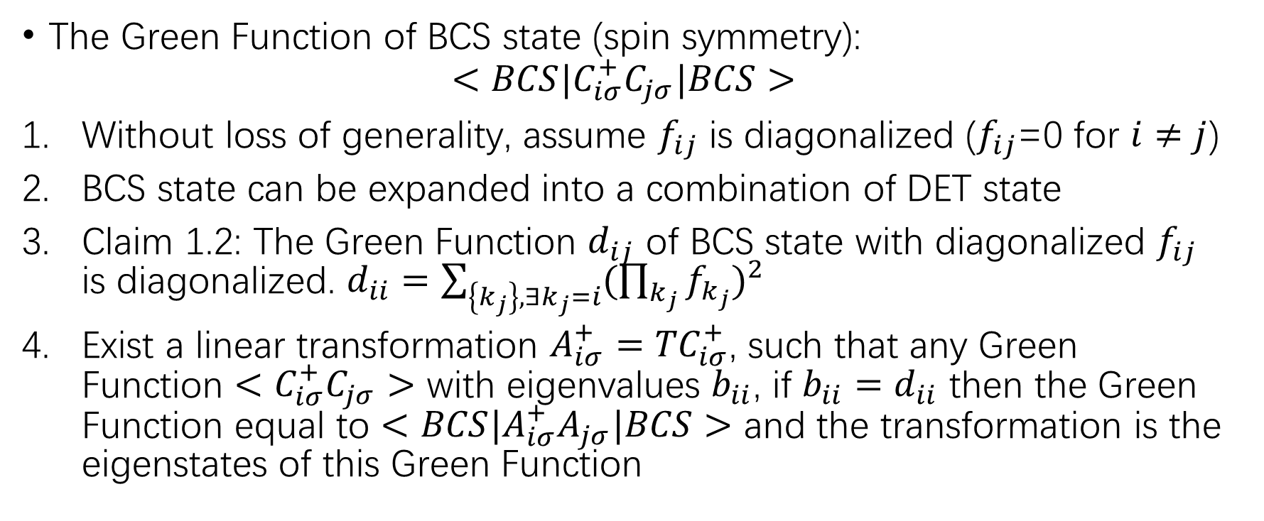
Introduction of the S.C. CPMC algorithm
The Green Function of BCS state (spin symmetry):
$$<BCS|C_{iσ}^{+}C_{jσ}|BCS>$$
Without loss of generality, assume $f_{ij}$ is diagonalized ($f_{ij}$=0 for $i≠j$)
BCS state can be expanded into a combination of DET state
Claim 1.2: The Green Function $d_{ij}$ of BCS state with diagonalized $f_{ij}$ is diagonalized. $d_{ii}=\sum_{\left\{k_{j}\right\},∃k_{j}=i}{{(\prod_{k_{j}}{f_{k_{j}}})}^{2}}$
Exist a linear transformation $A_{iσ}^{+}={TC}_{iσ}^{+}$, such that any Green Function $<C_{iσ}^{+}C_{jσ}>$ with eigenvalues $b_{ii}$, if $b_{ii}=d_{ii}$ then the Green Function equal to $<BCS|A_{iσ}^{+}A_{jσ}|BCS>$ and the transformation is the eigenstates of this Green Function

Slide 9
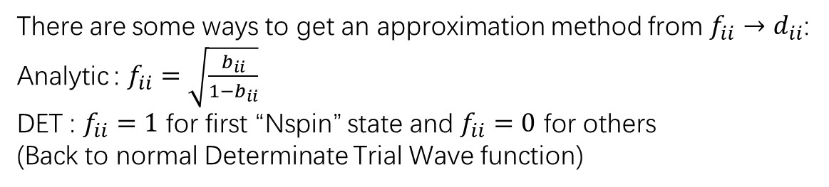
Introduction of the S.C. CPMC algorithm
Diagonalize the target Green Function and get the eigenstates $T_{ijσ}$, eigenvalues $b_{ii}$.
Diagonalize the target Green Function and get the eigenstates 𝑇_𝑖𝑗𝜎, eigenvalues 𝑏_𝑖𝑖.
Get BCS state $f_{ii}$ such that BCS Green Function $d_{ii}=b_{ii}$
Get BCS state 𝑓_𝑖𝑖 such that BCS Green Function 𝑑_𝑖𝑖=𝑏_𝑖𝑖
Then the BCS Trial Wave Function is $\overset{⃡}{F}=\overset{⃡}{T_{↑}}\overset{⃡}{f} \overset{⃡}{T_{↓}^{+}}$
Then the BCS Trial Wave Function is 𝐹 ⃡=(𝑇_↑ ) ⃡𝑓 ⃡ (𝑇_↓^+ ) ⃡
Green Function decomposition:
There are some ways to get an approximation method from $f_{ii}→d_{ii}$:
Analytic : $f_{ii}=\sqrt{\frac{b_{ii}}{1−b_{ii}}}$
DET : $f_{ii}=1$ for first “Nspin” state and $f_{ii}=0$ for others
(Back to normal Determinate Trial Wave function)

Slide 10


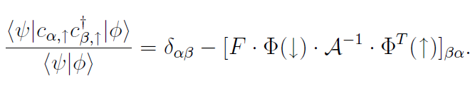
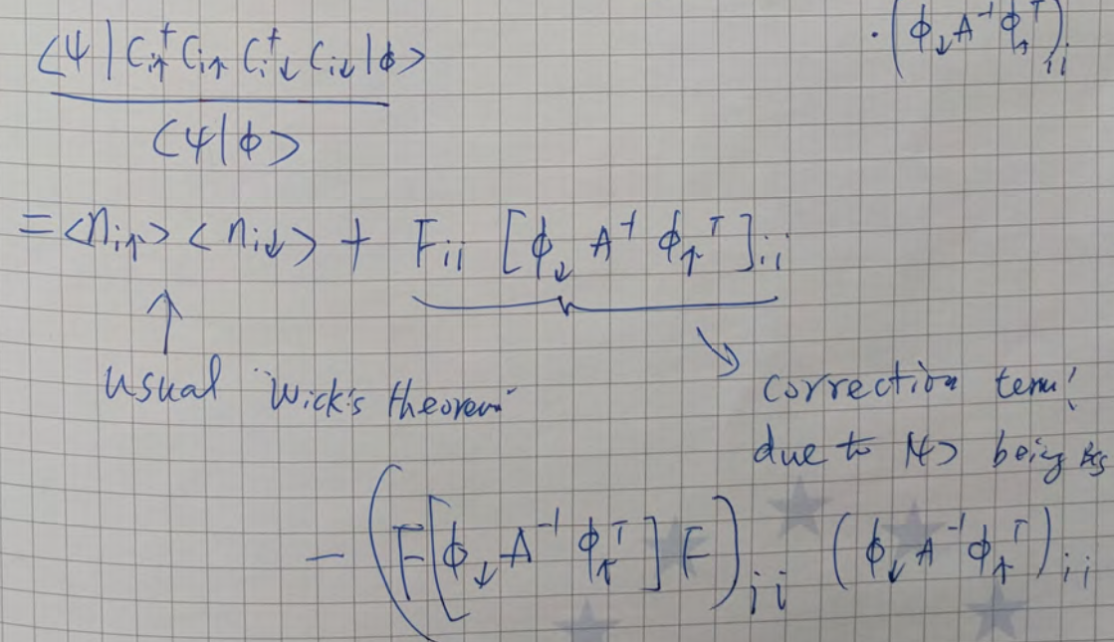

Introduction of the S.C. CPMC algorithm
brute force not S-M Formula to get_imp_inv
The $<n_{i}n_{j}>$ decomposition
[1]zhang, shiwei Notes: BCS trial WFs and Hubbard-like models.
[2]zhang, shiwei Notes: Calc-El-Hub-BCS-v1-ReduceFileSize

Slide 11

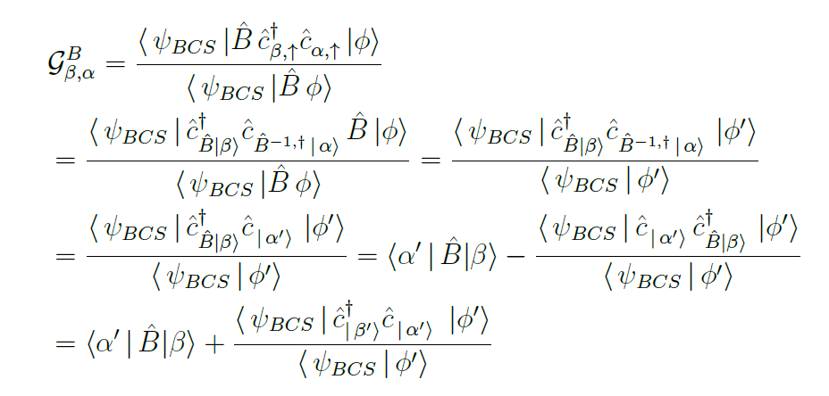
Introduction of the S.C. CPMC algorithm
Back Propagation
[1]Ettore Vitali Notes: finite_temperature_hfb

Slide 12
Introduction of the S.C. CPMC algorithm
Get a Trial Wave Function
CPMC Calculation
Get The Information of Ground State
Green Function decomposition
Modification for
BCS Trial Waves Function
Back Propagation for BCS state

Slide 13
The behavior of the S.C. CPMC algorithm in Hubbard Model
Better than normal CPMC at small U system
system | twist | input | decomposition method | BK/FW | walker | First step Energy | last 10 Ave Energy (20) | STDEV | Exact Energy | Error %
4477 u=4 | (0.01,0.02) | FS | Analytic | BK | 5*20*400 | -15.84913641 | -15.73447318 | 0.00939435 | -15.7660493 | -0.200279211
4477 u=4 | (0,0) | FS | Analytic | BK | 5*20*400 | -15.59054106 | -15.80229278 | 0.00579164 | -15.744 | 0.370253929
4477 u=8 | (0.01,0.02) | FS | Analytic | BK | 5*20*400 | -12.21852041 | -12.05883613 | 0.03900853 | -11.875287 | 1.545639529
4477 u=12 | (0.01,0.02) | FS | Analytic | BK | 5*20*400 | -10.52874468 | -9.930954499 | 0.03652032 | -10.0543472 | -1.22725721
481414 u=4 | (0,0) | FS | Analytic | BK | 5*20*400 | -32.98997521 | -33.07668737 | 0.01128522 | -33.07906 | -0.007172596
481414 u=4 | (0,0) | HF | Analytic | BK | 5*20*400 | -32.92587081 | -33.08020118 | 0.01004941 | -33.07906 | 0.003449868
481414 u=8 | (0,0) | FS | Analytic | BK | 5*20*400 | -24.71696699 | -24.5391534 | 0.05011579 | -24.6466022 | -0.435957817
481414 u=12 | (0,0) | FS | Analytic | BK | 5*20*400 | -21.01461539 | -20.38908399 | 0.14362547 | -20.7342593 | -1.664758335
481414 u=12 | (0,0) | HF | Analytic | BK | 5*20*400 | -20.11042073 | -20.50122603 | 0.14387467 | -20.7342593 | -1.123904484
481414 u=4 | closeopen | FS | Analytic | BK | 5*20*400 | -31.73779671 | -31.84122779 | 0.00813382 | -31.8609612 | -0.061935865
481414 u=6 | closeopen | FS | Analytic | BK | 5*20*400 | -26.80875277 | -26.85017159 | 0.01969928 | -26.824331 | 0.096332543
481414 u=8 | closeopen | FS | Analytic | BK | 5*20*400 | -23.70888722 | -23.48018192 | 0.04850598 | -23.5659852 | -0.364097846
system | B.C. | input | decomposition method | BK/FW | walker | First step Energy | last half Ave Energy | STDEV | Exact Energy
4122121 u=4 | closeopen | FS | Analytic | BK | 5*20*400 | -48.38039308 | -48.44568123 | 0.01159463 | -48.4397 | 0.012347778
4122121 u=6 | closeopen | FS | Analytic | BK | 5*20*400 | -40.87697676 | -40.92933387 | 0.02786377 | -40.779 | 0.368655117
4122121 u=8 | closeopen | FS | Analytic | BK | 5*20*400 | -36.11903901 | -35.76470789 | 0.05742049 | -35.8133 | -0.135681734
Error %
0.233
~
0.579
[1] Exact Energy at 4477 u=4,8,12 P.B.C. and Green Function at 4477 u=4,8,12 Twist B.C. , Exact Diagonalization, Shi Hao
[2] Shi, H. and Zhang, S. 2013. Symmetry in auxiliary-field quantum Monte Carlo calculations. Physical Review B. 88, 12 (2013), 125132.
[3] Exact Energy at 481414 u=4,8,12 P.B.C. , closeopen. Exact Energy at 4122121 u=4,6,8 closeopen , DMRG, Qin Mingpu

Slide 14
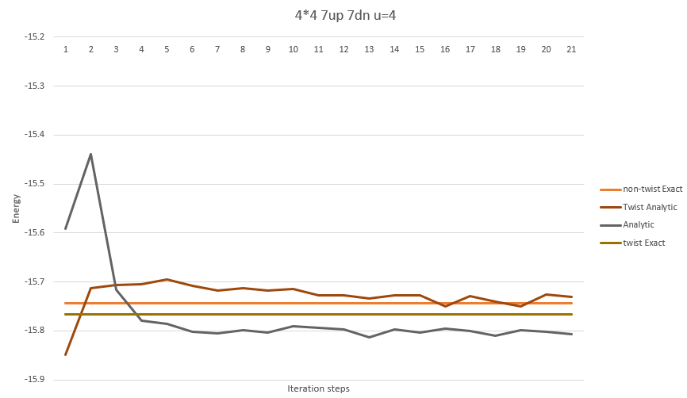
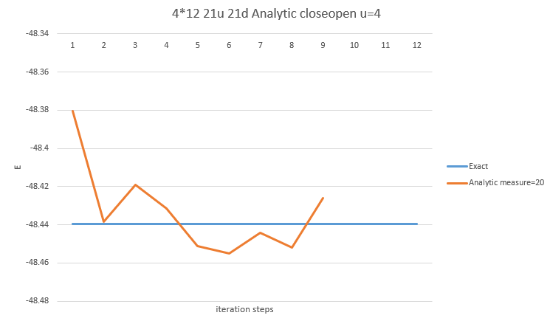
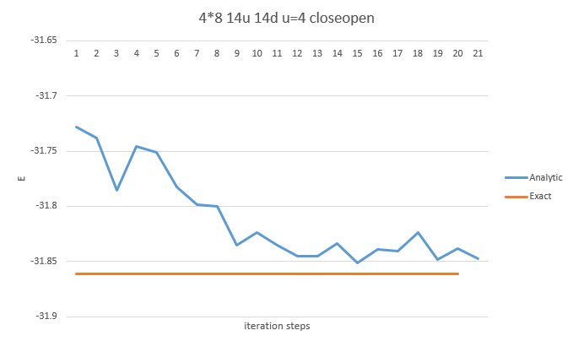
The behavior of the S.C. CPMC algorithm in Hubbard Model
Better than normal CPMC at small U system (Convergence behavior)

Slide 15
The behavior of the S.C. CPMC algorithm in Hubbard Model
Better than “old DET S.C. CPMC” (with real Green Function state)
(good Green Function Decomposition method):
system | twist | input | decomposition method | BK/FW | walker | Energy | STDEV | Exact Energy | Error % | converge (20)
4477 u=4 | (0.01,0.02) | non_twist Exact first=0.44 other 0.4375 | Analytic | BK | 5*20*400 | -15.79085284 | 0.016070284 | -15.766049 | -0.15732251 | -15.70698469
4477 u=4 | (0.01,0.02) | non_twist Exact first=0.44 other 0.4375 | DET | BK | 5*20*400 | -15.68002468 | 0.016072148 | -15.766049 | 0.545632086 | -15.67964298
4477 u=4 | (0,0) | non_twist Exact first=0.44 other 0.4375 | Analytic | BK | 5*20*400 | -15.76565116 | 0.021297804 | -15.744 | -0.13752008 | -15.80694989
4477 u=4 | (0,0) | non_twist Exact first=0.44 other 0.4375 | DET | BK | 5*20*400 | -15.65028647 | 0.012408288 | -15.744 | 0.595233307 | -15.64890772
4477 u=8 | (0.01,0.02) | twist Exact first=0.44 other 0.4375 | Analytic | BK | 5*20*400 | -11.87328862 | 0.070350113 | -11.875287 | 0.016828014 | -12.05354462
4477 u=8 | (0.01,0.02) | twist Exact first=0.44 other 0.4375 | DET | BK | 5*20*400 | -11.75788655 | 0.034641026 | -11.875287 | 0.988611459 | -11.97751391
4477 u=12 | (0.01,0.02) | twist Exact first=0.44 other 0.4375 | Analytic | BK | 5*20*400 | -10.04566011 | 0.126862648 | -10.054347 | 0.086401341 | -9.85424718

Slide 16
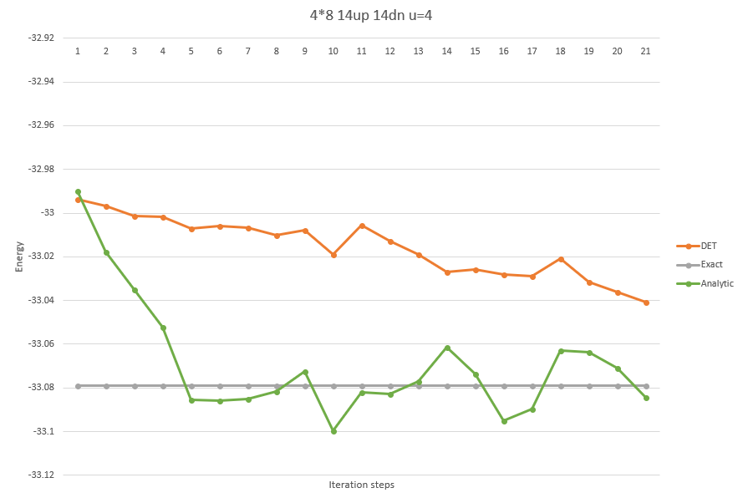
The behavior of the S.C. CPMC algorithm in Hubbard Model
Better than “old DET S.C. CPMC” at small U
(good Green Function Decomposition method):

Slide 17
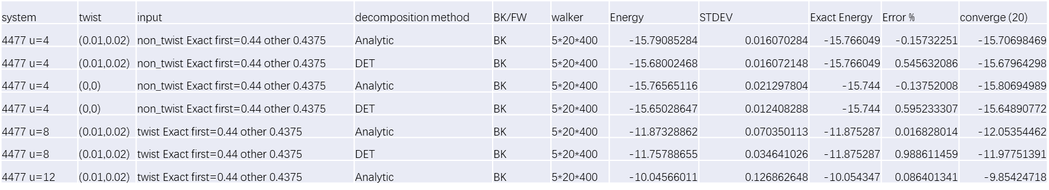
Some problems need to be solved next
Green Function need modification at 4*4 system with Exact input
The Exact Green Function is not conserved along the SC steps

Slide 18
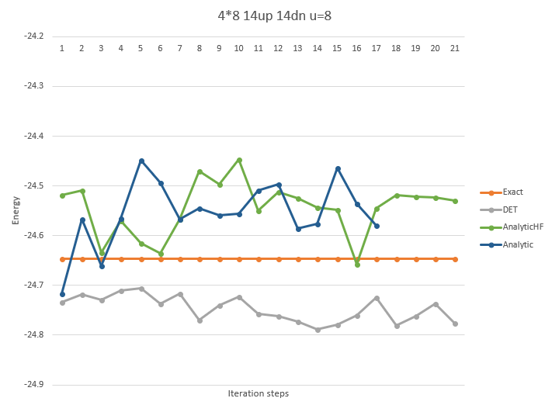
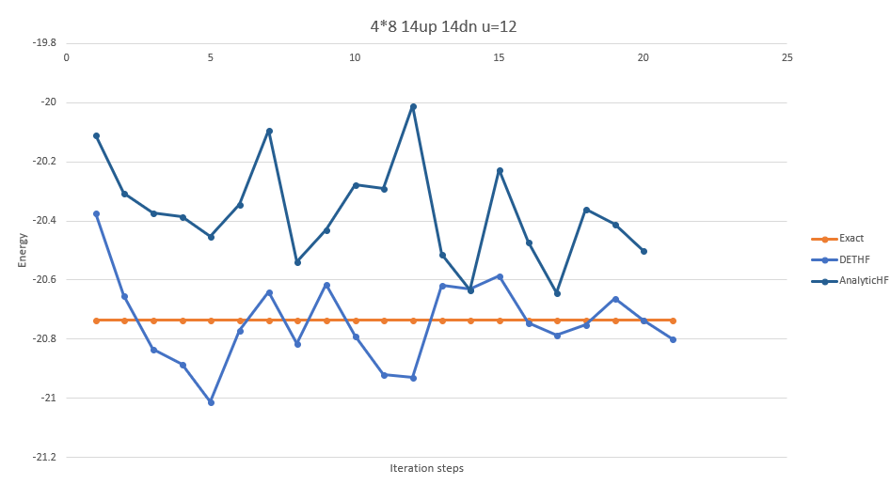
Some problems need to be solved next
Bad behavior at large U system
Green Function Modification
→Better Decomposition Method

Slide 19
Some problems need to be solved next
How to apply BCS S.C. CPMC to spin symmetry break system?

Slide 20
Application
Using Green Function as Trial Wave Function more directly
In some system (like small U system), BCS S.C. work better
Connecting other methods together to improve the results

Slide 21
Thanks

